Slide 1
DATA PREPROCESSING AND EDA
BY
Sushant Ovhal
sushantrovhal@gmail.com
30/12/2022

Slide 2
Table of contents
Aim
Objective
Introduction
Research Questions
Exploratory Analysis and Visualization
Conclusion
future work
Reference

Slide 3
Aim
This project aims to collect and analyze the data of the US Accidents Dec21 and also analyze the Accidence according to city, country, season wise and find out the Reasons and meaning full information.

Slide 4
Objective
The main objective of this project is to data cleaning, remove null values, data pre-processing for machine learning and remove outliers and we need to improve the performance of the data set.

Slide 5
Introduction
This project analyses accident data collected from 49 states of the United States of America over the period between February 2016 and December 2020. The set is sourced from Kaggle. It has a total of 29,06,610 rows and 47 columns; inclusive of but not limited to variables such as ‘State’, ‘City’, ‘Start_Time’, ‘Temperature(F)’, ‘Weather Condition’ etc

Slide 6
Research Questions
1) Are there more accidents in warmer or colder areas?
2) Which 5 states have the highest number of accidents?
3) Does New York show up in the data? If yes, why is the count lower if this is the most populated city?
4) Among the top 100 cities in number of accidents, which states do they belong to most frequently?
5) What time of the day are accidents most frequent?
6) Which days of the week have the most accidents?
7) What is the trend of accidents year over year (Decreasing/ Increasing) .

Slide 7
Exploratory Analysis and Visualization

Slide 8
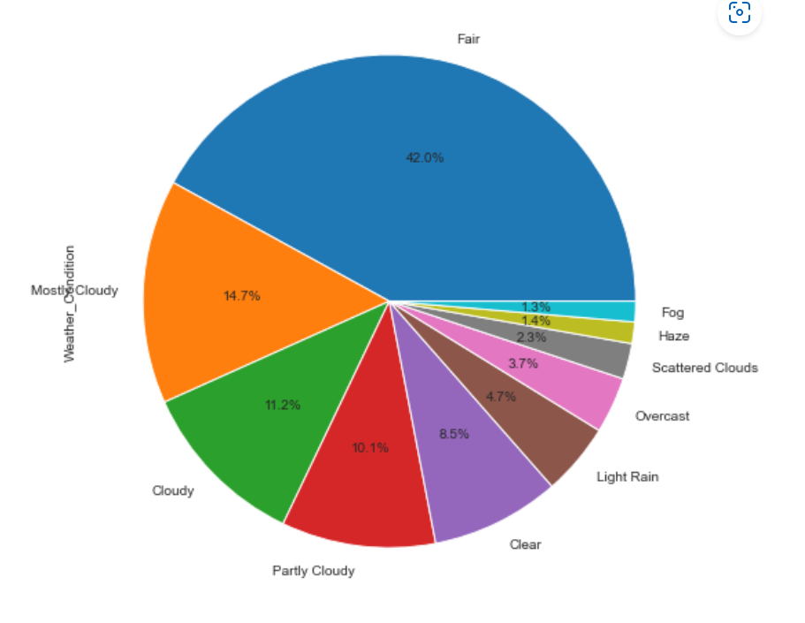
1) Plot the pia chart of the Accident occure because of the weather condition.

Slide 9
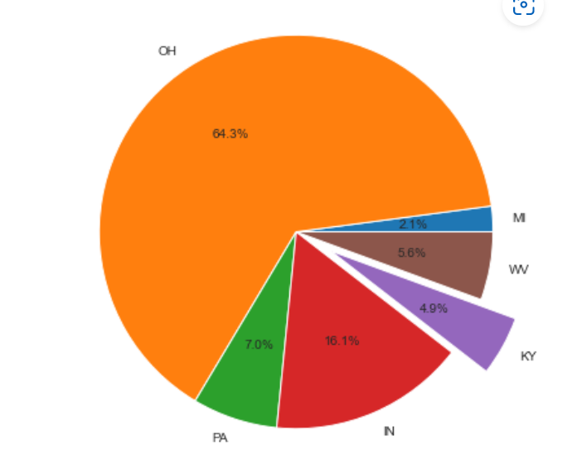
2) Plot the Pia chart of states have the highest number of accidents

Slide 10
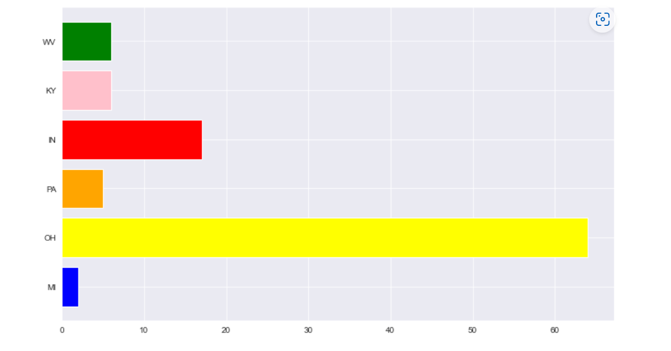
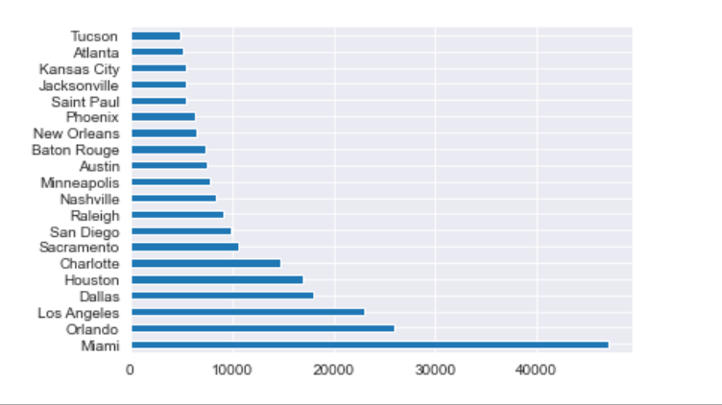
3) Among the top 100 cities in number of accidents, which states do they belong to most frequently.

Slide 11
Conclusion
Traffic accidents are a main public safety issue, with much research devoted to the analysis and prediction of these rare events. The study helped us to derive factors that are responsible for accidents. From this dataset, a variety of insights concerning the location, time, weather, and points-of-interest of an accident are found. The analysis helps us understand the best month, day, and hour of the day to travel.
1) Are there more accidents in warmer or colder areas?
Ans :- Warmer - 0
colder - 0

Slide 12
Conclusion
2) Which 5 states have the highest number of accidents?
Ans :- California, Florida, Texas, Oregon, Virginia.
3) Does New York show up in the data? If yes, why is the count lower if this is the most populated city?
Ans :- The New York is not showing in the data.
4) Among the top 100 cities in number of accidents, which states do they belong to most frequently?
Ans:- Miami, Los Angeles, Orlando, Dallas, Houston.

Slide 13
Conclusion
5) What time of the day are accidents most frequent?
Ans :- 11am to 7pm
6) Which days of the week have the most accidents?
Ans :- Monday
7) Which months have the most accidents?
Ans :- December has the most number of accidents.
8) What is the trend of accidents year over year (Decreasing/ Increasing) .
Ans:- It is exponentially increasing

Slide 14
Future work
We can find confusion matrix, Lenear Regression, Random forest tree etc.
Per-Capita accident figures can be analyzed if the population data is sourced from authentic sources.
An exponential rise in accidents was seen in the year 2020-2021, further analysis using external sources can be done to figure out the reason.
Predictive analysis can be done which will help in devising ways to prevent further accidents.
Various parameters like Humidity, Pressure, Severity, etc. which haven't been considered for this particular analysis, can be analysed to gain more insights.

Slide 15
Reference
Github.com
kaggel.com
Google.com

Slide 16
Thank You

